Slide 1

GUESS THE WORD
Siddharth MAndgi

Slide 2
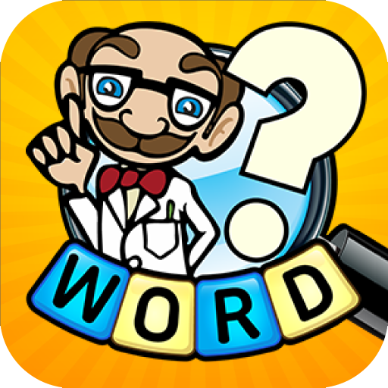

WHAT IS THIS PROJECT ABOUT ?
This project is an interactive python game having a graphical user interface.
This project is compatible to python 2 and 3 .
To implement the logic we need to use Classes and Methods in python .
To enable the GUI we need to use a library called as Tkinkter.

Slide 3
HOW will THE GAME BE PLAYED ? USER INSTRUCTIONS.
It is a fairly simple game where a series of riddles are asked and the user has to guess the answer in a single word. It is a sudden death game.
If the user guesses the right answer then he moves on to the next question.
If the user guesses the wrong answer the game stops there and then and conveys the message that the user has lost.

Slide 4
LIBRARIES AND DETAILS REQUIRED TO BUILD THIS CODE.
The Basic library required to build this code is Tkinter.
And python installed basically of version 2 or 3.
IDE used – PyCharm.

Slide 5
TKINTER
Tkinter is Python's de-facto standard GUI (Graphical User Interface) package.
It is a thin object-oriented layer on top of Tcl/Tk.
Tkinter is not the only Gui Programming toolkit for Python. It is however the most commonly used one.
It is a preinstalled library in python you can check its version by using the following commands in your terminal :- python3 import tkinter tkinter.TkVersion

Slide 6
Challenges Faced
Getting the right algorithm
Syntax errors
Text overlapping because because of improper refreshing between questions.
Questions repeating again and again along with randomizing.

Slide 7
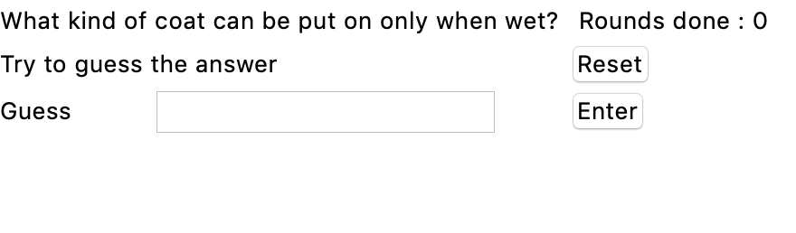
FINAL OUTPUT

Slide 8
Acknowledgment
I would like to express my gratitude to our Professor : - Sergul Aydore for helping us learn the basics of python because of which I was able gain knowledge and create this project in python.

Slide 9
THANK YOU

